Slide 1

Geometry
Unit 6, Lesson 11 Solving Problems Using Similarity – Part 1 Volume 1, pg. 353

Slide 2


Benchmark
MA.912.GR.1.6
Solve mathematical and real-world problems involving congruence or similarity in two-dimensional figures.
volume 1, pg. 353

Slide 3
Integrated Mathematical Thinking and Reasoning Standards
MA.K12.MTR.1.1 Actively participate in effortful learning both individually and collectively.
MA.K12.MTR.3.1 Complete tasks with mathematical fluency.
MA.K12.MTR.4.1 Engage in discussions that reflect on the mathematical thinking of self and others.
MA.K12.MTR.5.1 Use patterns and structure to help understand and connect mathematical concepts.
MA.K12.MTR.6.1 Assess the reasonableness of solutions.
MA.K12.MTR.7.1 Apply mathematics to real-world contexts.
volume 1, pg. 353

Slide 4

Learning Target
I can solve mathematical problems involving similarity in two-dimensional figures.
volume 1, pg. 353

Slide 5

Warm-Up
volume 1, pg. 354

Slide 6
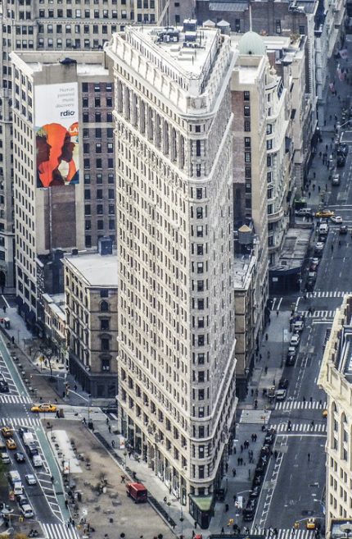
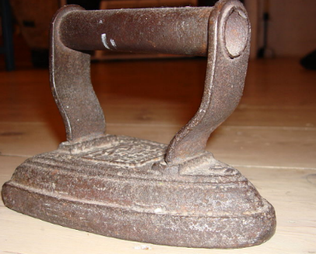
6.11.1 Warm-Up: The Flatiron Building
The Flatiron Building, designed by Daniel Burnham and built in 1902, is a triangular 22-story building located in New York City. The building sits on a triangular block formed by 5th Avenue, Broadway, and East 22nd Street. The building got its name from an old-fashioned flat iron.
Although the ground base appears to be an isosceles triangle, the base of the Flatiron Building is actually a right triangle. Morgan used a map to draw a triangle that models the base of the building.
volume 1, pg. 354

Slide 7
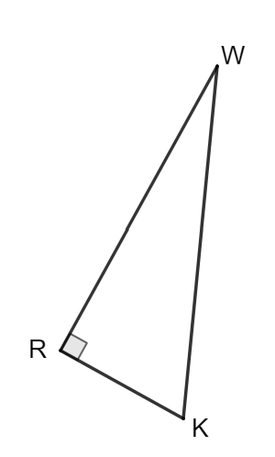
What other measurement should Morgan check to be sure her drawing is similar to the building?
Fifth Ave.
Broadway
volume 1, pg. 354

Slide 8

Collaboration
volume 1, pg. 354

Slide 9

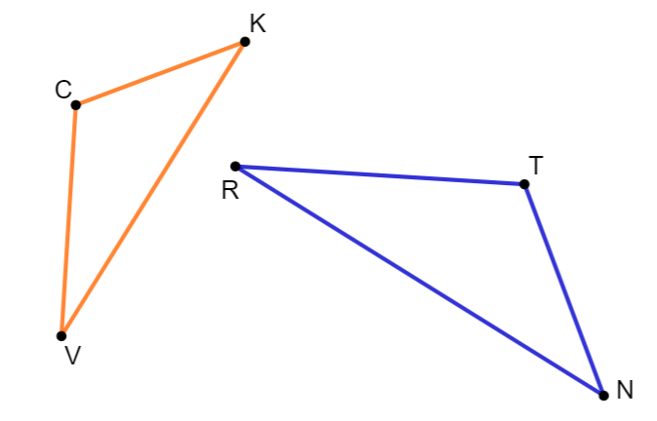

6.11.2 Collaboration: Similar Figures
$∆CKV$ and $∆TNR$ are shown, where $∆CKV\sim ∆TNR$.
Some measurements of the angles in $∆CKV$ and $∆TNR$ are given.
$m∠TRN=28°$, $m∠VCK=(8x+26)°$, and $m∠RTN=(12x−8)°$.
Determine each.
$$x= __________ m∠CKV= __________$$
volume 1, pg. 354

Slide 10
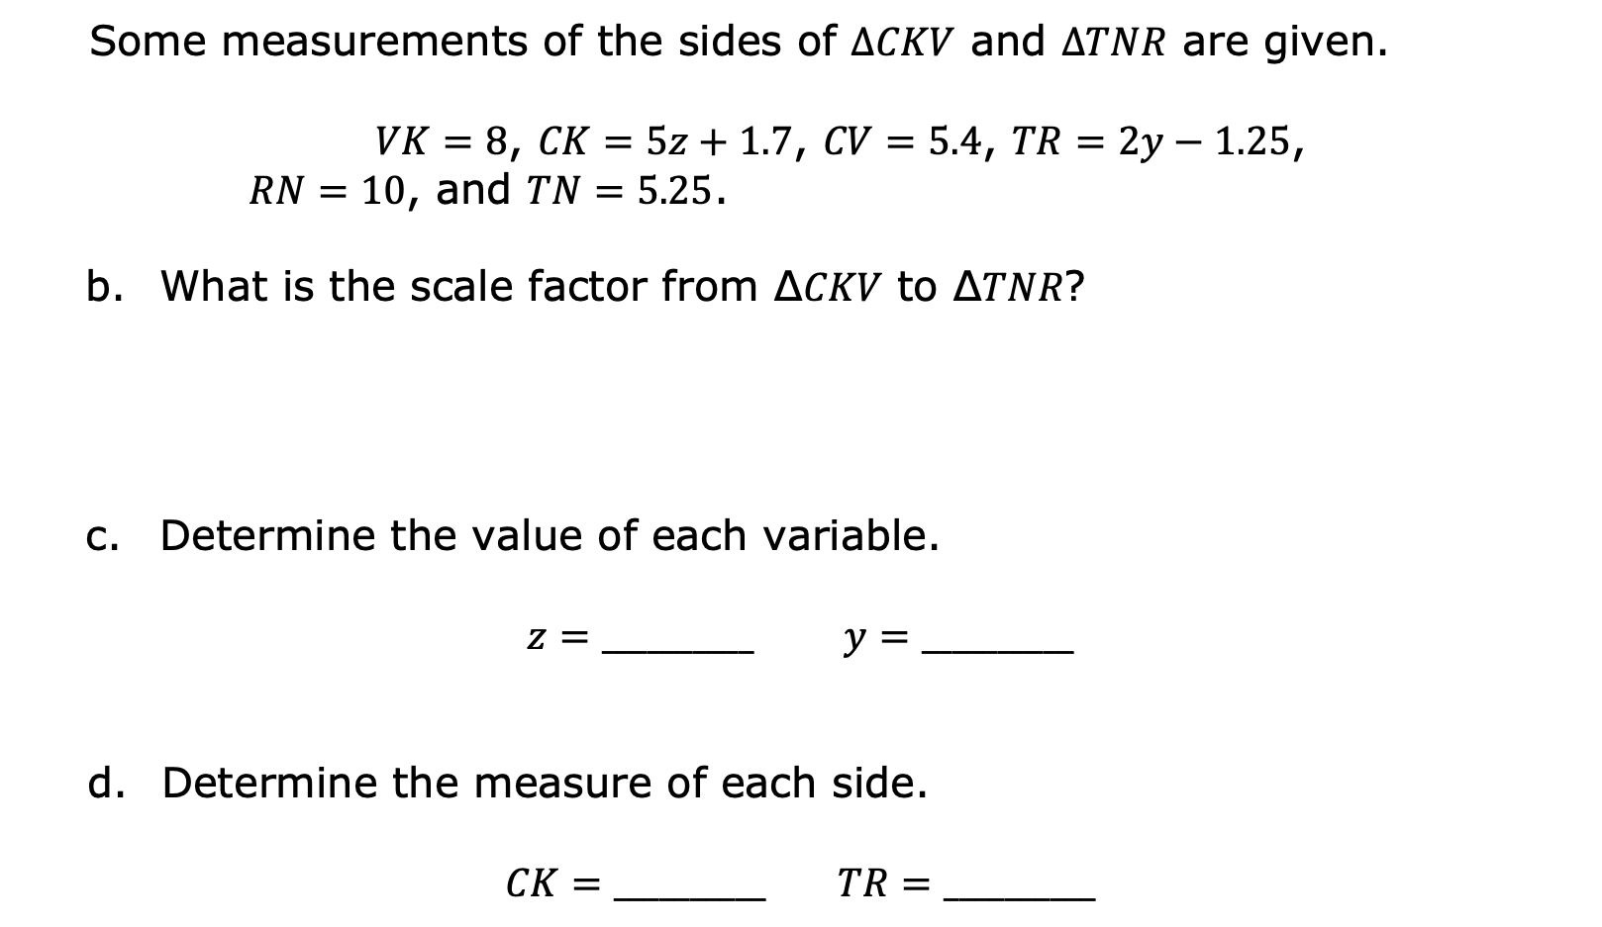
Some measurements of the sides of $∆CKV$ and $∆TNR$ are given.
$VK=8$, $CK=5z+1.7$, $CV=5.4$, $TR=2y−1.25$,
$RN=10$, and $TN=5.25$.
What is the scale factor from ∆𝐶𝐾𝑉 to ∆𝑇𝑁𝑅?
Determine the value of each variable.
$$z=__________ y=__________$$
Determine the measure of each side.
$$CK=__________ TR=__________$$
volume 1, pg. 355

Slide 11
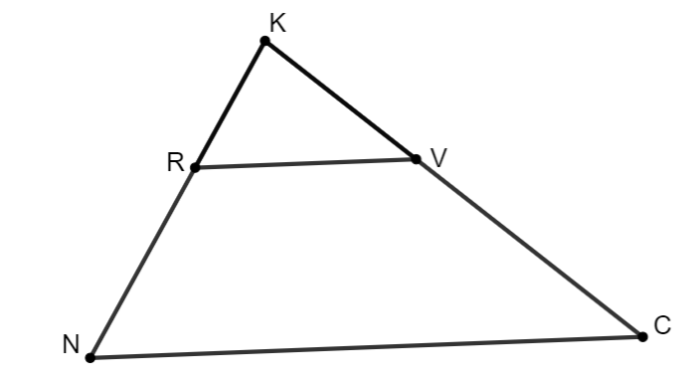
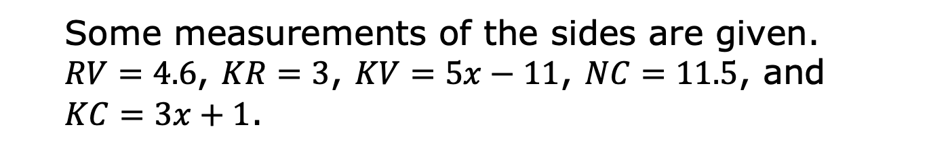
$∆KVR$ and $∆KCN$ are shown, where $∆KVR\sim ∆KCN$.
Some measurements of the sides are given.
$RV=4.6$, $KR=3$, $KV=5x−11$, $NC=11.5$, and
$KC=3x+1$.
volume 1, pg. 355

Slide 12
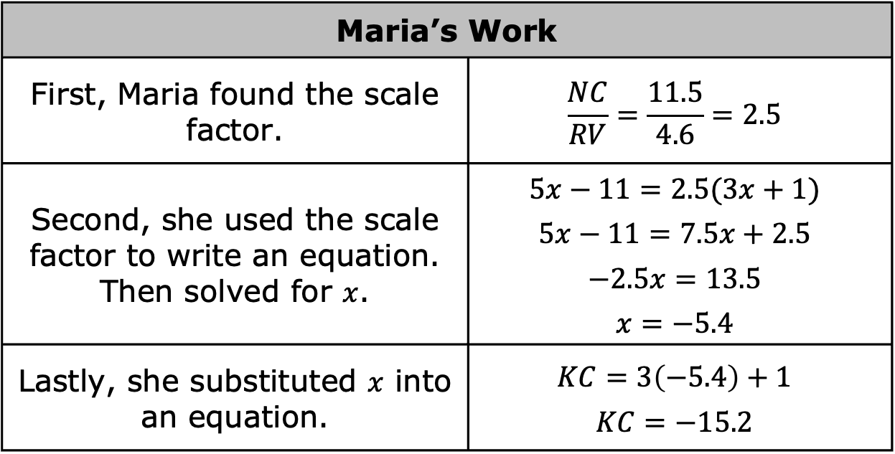
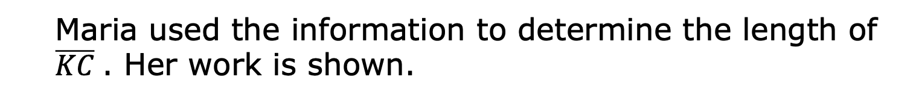
Maria used the information to determine the length of $\overline{KC}$. Her work is shown.
Maria’s Work
First, Maria found the scale factor. | $$\frac{NC}{RV}=\frac{11.5}{4.6}=2.5$$
Second, she used the scale factor to write an equation. Then solved for $x$. | $$5x−11=2.5(3x+1)$$ $$5x−11=7.5x+2.5$$ $$−2.5x=13.5$$ $$x=−5.4$$
Lastly, she substituted $x$ into an equation. | $$KC=3\left(−5.4\right)+1$$ $$KC=−15.2$$
Maria knows side lengths cannot be negative values, but she does not know what she did wrong.
volume 1, pg. 355

Slide 13
Find and circle Maria’s error.
Write a note to Maria explaining what her mistake was and how she can learn from the mistake.
Means
I
Start
To
Acquire
Knowledge
Experience
Skills
volume 1, pg. 356

Slide 14

Your Turn
volume 1, pg. 356

Slide 15
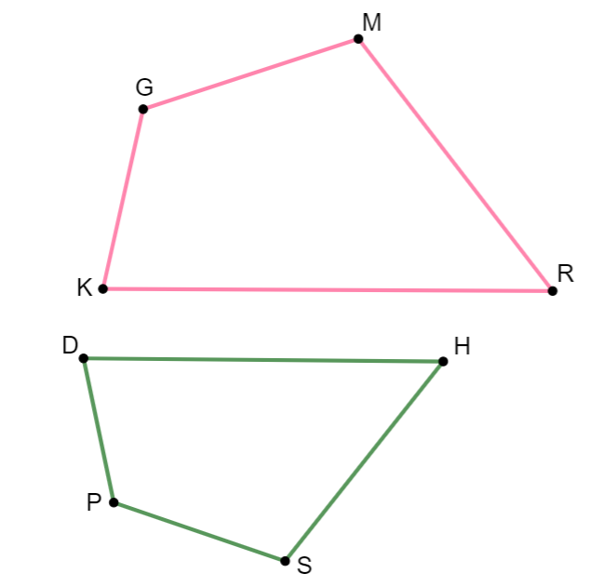

6.11.3 Your Turn!
$GMRK$ and $PSHD$ are shown, where $GMRK \sim PSHD$.
Some measurements of the sides of 𝐺𝑀𝑅𝐾 and 𝑃𝑆𝐻𝐷 are given.
$KG=12$, $GM=4x−12$, $MR=7k−15$, $DP=9.6$, $SP=12.8$, $KR=30$, and $SH=4k−4$.
Determine the value of each variable.
$x=$__________ $k=$__________
volume 1, pg. 356

Slide 16
Determine the value of each side.
𝐺𝑀=__________ 𝐷𝐻=__________
𝑆𝐻=__________
What is the perimeter of 𝐺𝑀𝑅𝐾?
volume 1, pg. 357

Slide 17
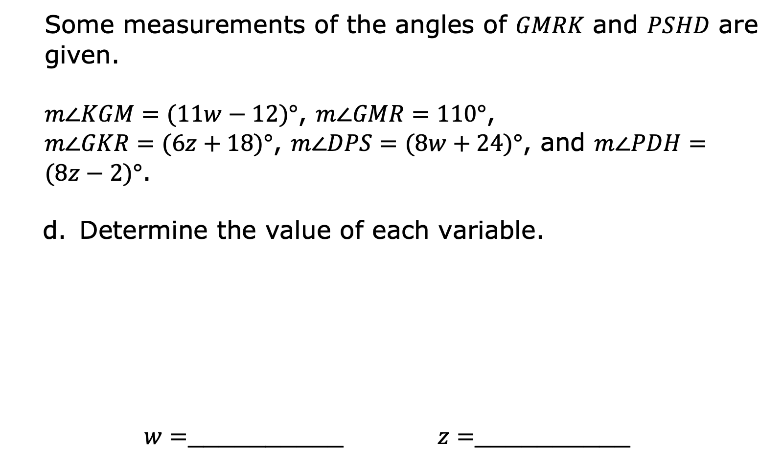
Some measurements of the angles of 𝐺𝑀𝑅𝐾 and 𝑃𝑆𝐻𝐷 are given.
$m∠KGM=(11w−12)°$, $m∠GMR=110°$,
$m∠GKR=(6z+18)°$, $m∠DPS=(8w+24)°$, and $m∠PDH=(8z−2)°$.
Determine the value of each variable.
$w=$__________ $z=$__________
volume 1, pg. 357

Slide 18

Determine the value of each angle.
$m∠KGM=_________$ $m∠DHS=_________$
$$m∠PDH=__________$$
volume 1, pg. 357

Slide 19

Wrap-Up
volume 1, pg. 358

Slide 20
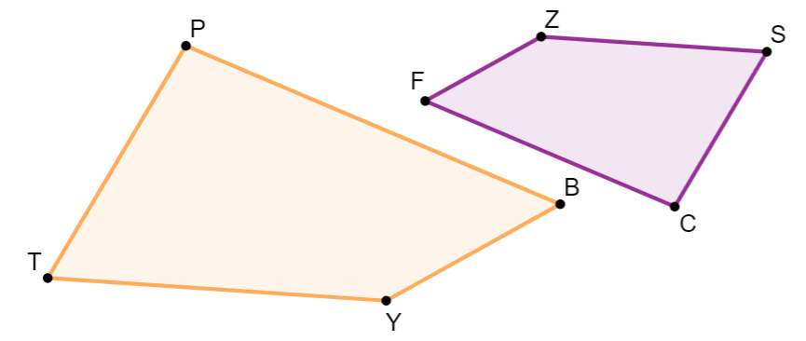
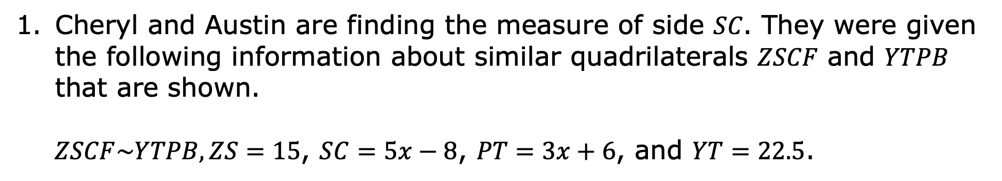
6.11.4 Wrap-Up: Error Analysis
Cheryl and Austin are finding the measure of side 𝑆𝐶. They were given the following information about similar quadrilaterals 𝑍𝑆𝐶𝐹 and 𝑌𝑇𝑃𝐵 that are shown.
$ZSCF\sim YTPB, ZS=15$, $SC=5x−8$, $PT=3x+6$, and $YT=22.5$.
volume 1, pg. 358

Slide 21
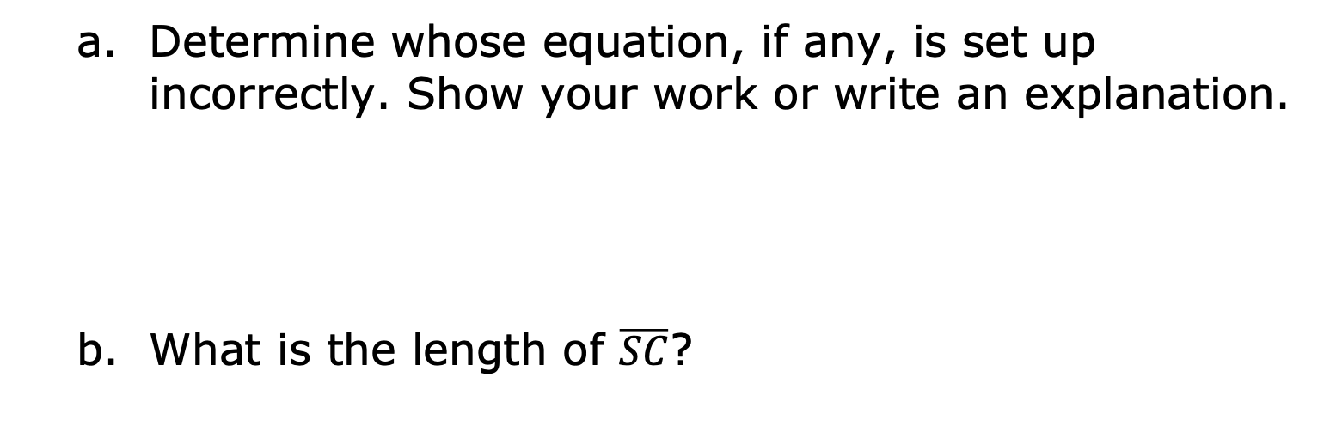
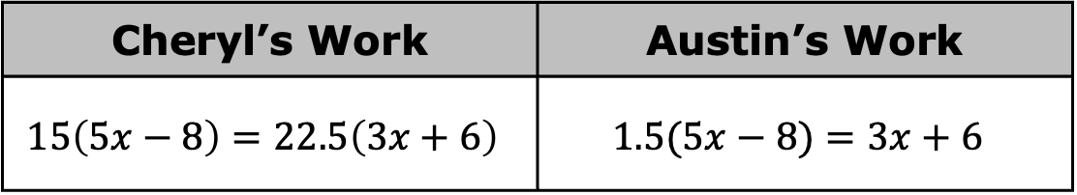
Cheryl’s and Austin’s equations are shown.
Cheryl’s Work | Austin’s Work
$$15\left(5x−8\right)=22.5\left(3x+6\right)$$ | $$1.5(5x−8)=3x+6$$
Determine whose equation, if any, is set up incorrectly. Show your work or write an explanation.
What is the length of $\overline{SC}$?
volume 1, pg. 358

